Slide 1
M9

Slide 2
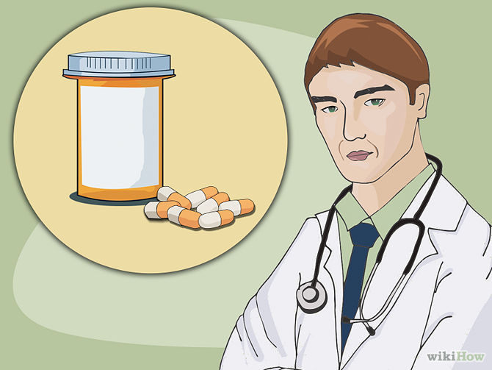
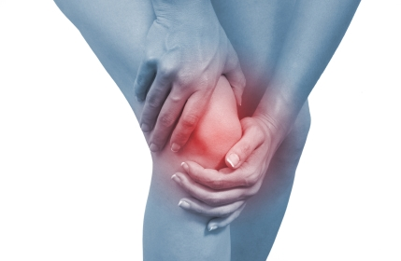
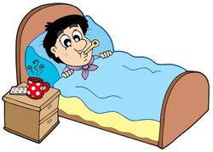
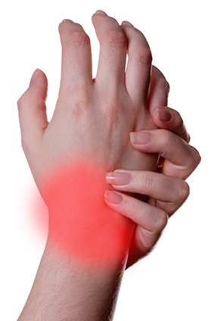

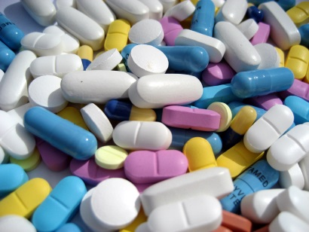
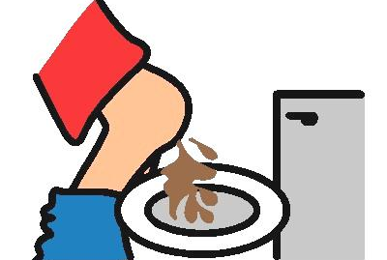
Principles of treatment
There are two ways to treat an infectious disease.
One would be to reduce the effects of the disease and the other to kill the cause of the disease.
For the first, we can provide treatment that will reduce the symptoms.
The symptoms are usually because of inflammation.
For example, we can take medicines that bring down fever, reduce pain or loose motions.
We can take bed rest so that we can conserve our energy.

Slide 3

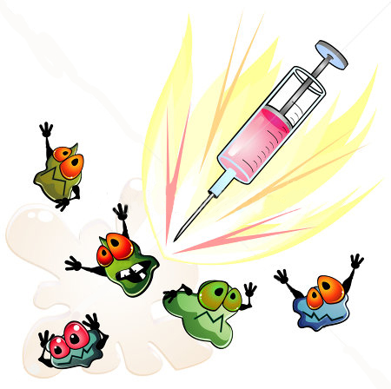
Principles of treatment
This will enable us to have more of it available to focus on healing.
But this kind of symptom-directed treatment by itself will not make the infecting microbe go away and the disease will not be cured.
For that, we need to be able to kill off the microbes.

Slide 4

Principles of treatment
How do we kill microbes?

Slide 5

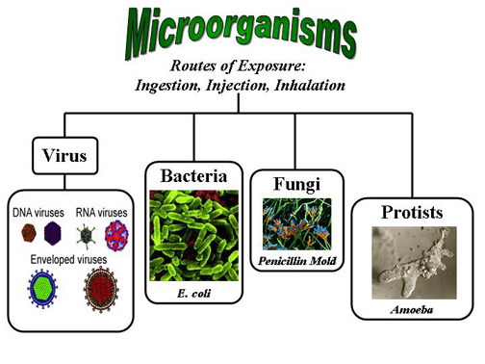
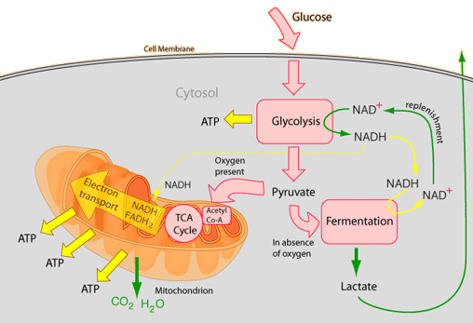
Principles of treatment
One way is to use medicines that kill microbes.
We have seen earlier that microbes can be classified into different categories.
They are viruses, bacteria, fungi or protozoa.
Each of these groups of organisms will have some essential biochemical life process which is peculiar to that group and not shared with the other groups.
These processes may be pathways for the synthesis of new substances or respiration.
Virus
Bacteria
Fungi
Protozoa

Slide 6
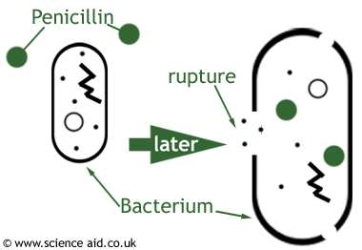
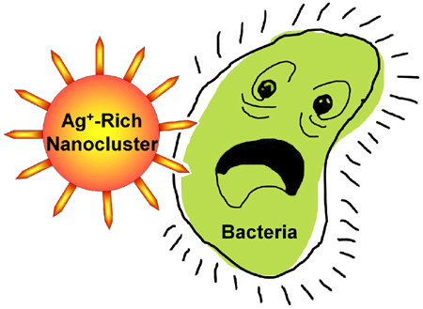


Principles of treatment
We have to find a drug that blocks the bacterial synthesis pathway without affecting our own.
This is what is achieved by the antibiotics that we are all familiar with.
Similarly, there are drugs that kill protozoa such as the malarial parasite.
One reason why making anti-viral medicines is harder than making antibacterial medicines is that viruses have few biochemical mechanisms of their own.
Antibiotics

Slide 7
Principles of treatment
They enter our cells and use our machinery for their life processes.
This means that there are relatively few virus-specific targets to aim at.
Despite this limitation, there are now effective anti-viral drugs, for example, the drugs that keep HIV infection under control.

